Slide 1
SOF 103
C and C++ Programming
Friend Function
Function Overriding vs Function Overloading
Virtual Base Class
Virtual Member Function, Pure Virtual Function, Abstract Class
Polymophism
Multiple Inheritance

Slide 2
Vision and Mission
Vision
Xiamen University Malaysia aspires to become a university with a distinct global outlook, featuring first-class teaching and research, and embracing cultural diversity.
Mission
To nurture young talents with dignity and wisdom, turning them into fine citizens of the region who will contribute to the prosperity of the people and social progress of Malaysia, China and Southeast Asia.
Compile by Dr. Hew

Slide 3
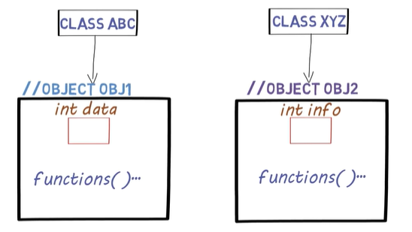
Friend Functions
Suppose we have two different classes: ABC and XYZ

Slide 4
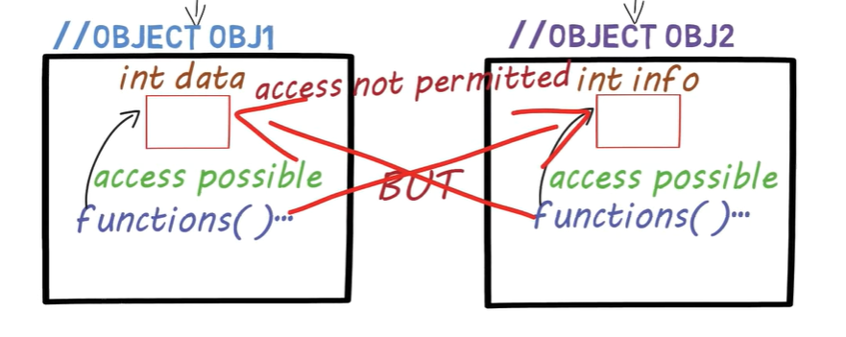
Friend Functions
The function can only access the member variables of the same class. The function cannot access the member variable of different class.

Slide 5
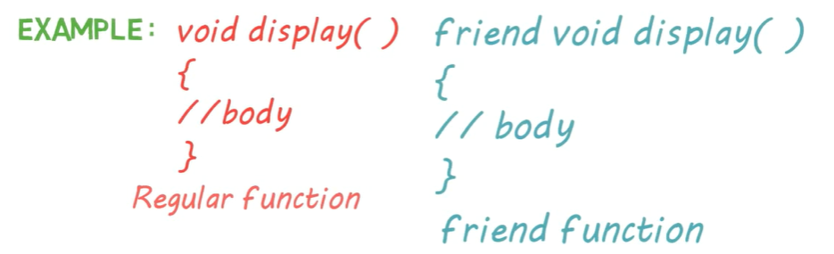
Friend Functions
If you need to access both data and info variables, then we use Friend Function.
Syntax of Friend function:
Add friend in front of member function

Slide 6
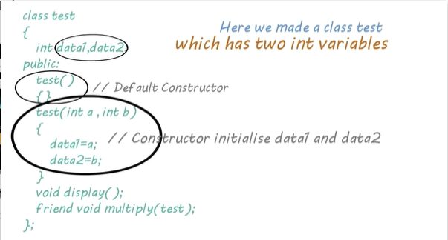
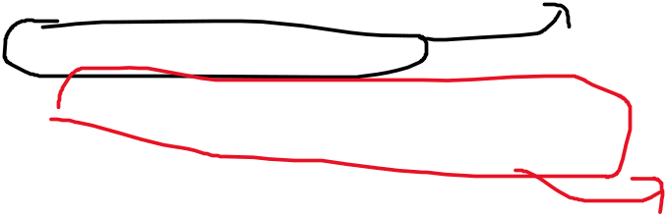
Friend Functions
Normal function declaration.
Friend function declaration

Slide 7
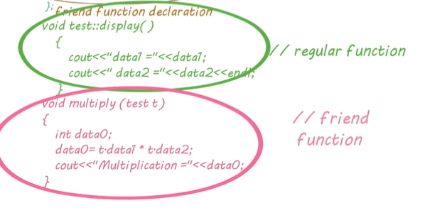
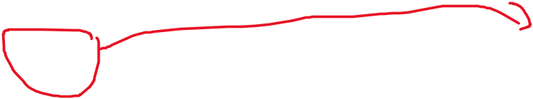
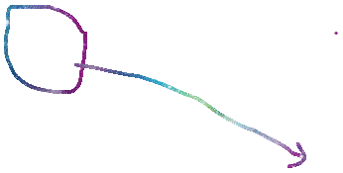
Friend Functions
Let define these two function: display(), multiply()
It is in the scope of class test
It is not in the scope of class test
Why we use object of class as argument? Because friend function needs object name access private variables.

Slide 8
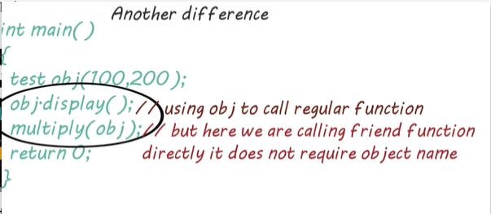
Friend Functions

Slide 9
Friend Functions vs Regular Function
Friend Function | Regular Function
Not in scope of class | In scope of class
Cannot be called using object of class | Need object to call function
Need object name and dot(.) to access private variables | Directly access private variables
Can be defined in private, protected, public | Only declare in public

Slide 10
Friend Function in Multiple Classes
using namespace std;
class Teacher;
class President{
int salary;
public:
President(){}
President(int s){salary=s;}
void displayPsalary()
{
cout<<" President salary is "<<salary<<endl;
}
friend void totalSalary(President, Teacher);
};

Slide 11
Cont…
class Teacher
{
int salary;
public:
Teacher(){}
Teacher(int s){salary=s;}
void displayTsalary()
{
cout<<" Teacher salary is "<<salary<<endl;
}
friend void totalSalary(President, Teacher);
};
void totalSalary(President p, Teacher t)
{
cout<<"Total salary is "<<p.salary+t.salary<<endl;
}

Slide 12
Cont…
int main()
{
President p(10000);
p.displayPsalary();
Teacher t(5000);
t.displayTsalary();
totalSalary(p,t);
return 0;
}

Slide 13
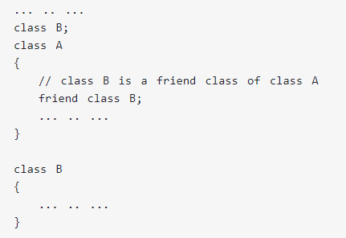
Friend Class
Similarly, like a friend function, a class can also be made a friend of another class using keyword ”friend”, e.g.,

Slide 14
Friend Class – Cont…
When a class is made a friend class, all the member functions of that class becomes friend functions.
Here, all members of class B will be friend functions of class A.
Thus, any member function of class B can access the private and protected data of class A. But, member functions of class A cannot access the data of class B.

Slide 15
Friend Function & Friend Class Example
class Rectangle
{
private:
float length, width, area;
public:
void setArea(float l, float w)
{
length=l;
width=w;
area=length*width;
}
};
int main()
{
Rectangle r;
r.setArea(4,5);
cout<<"Area is "<<r.area;
return 0;
}
The above codes got error!!! How do you rectify it?

Slide 16
Solutions
1st solution. Move all the private data to the public.
2nd solution. Using friend function.
3rd solution. Using friend class.

Slide 17
1st solution
class Rectangle
{
public:
float length, width, area;
void setArea(float l, float w
length=l;
width=w;
area=length*width;
}
};
int main()
{
Rectangle r;
r.setArea(4,5);
cout<<"Area is "<<r.area;
return 0;
}

Slide 18
2nd solution
class Rectangle
{
private:
float length, width, area;
public:
void setArea(float l, float w)
{
length=l;
width=w;
area=length*width;
}
friend void displayArea(Rectangle);
};
void displayArea(Rectangle r)
{
cout<<r.area;
}
int main()
{
Rectangle r;
r.setArea(4,5);
cout<<"Area is ";
displayArea(r);
return 0;
}

Slide 19
3rd solution
class Rectangle
{
private:
float length, width, area;
public:
void setArea(float l, float w)
{
length=l;
width=w;
area=length*width;
}
friend class Print;
};
//Third solution. Using Friend Class.
class Print
{
public:
void displayArea(Rectangle r)
{
cout<<r.area;
}
};
int main()
{
Rectangle r;
r.setArea(4,5);
Print p;
cout<<"Area is ";
p.displayArea(r);
return 0;
}

Slide 20
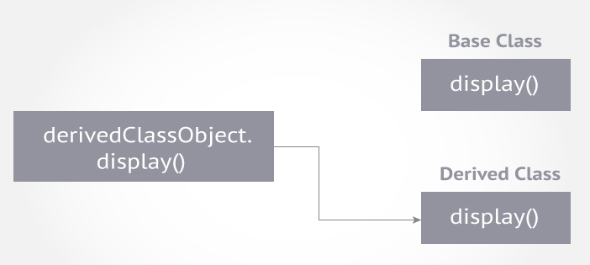
Function Overriding
The concept:
Suppose, both base class and derived class have a member function with same name and arguments (number and type of arguments).

Slide 21
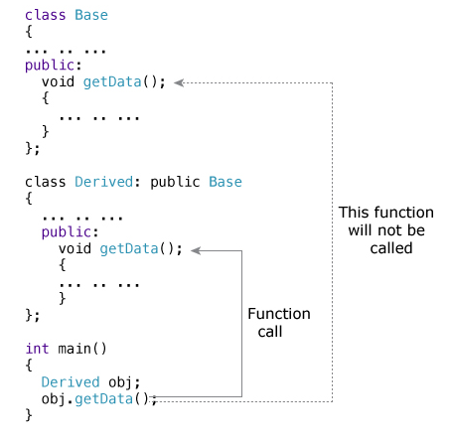
Cont…
Which function will be called when object of class Derived calls getData() function?
The compiler will give the preference to object type. In this case, the function in derived class will be called.

Slide 22
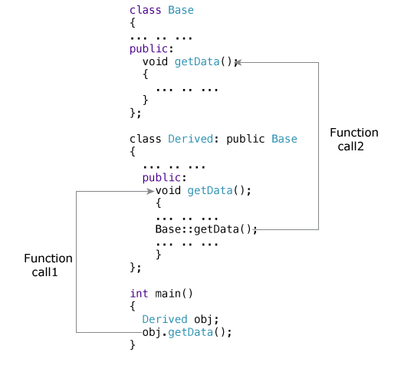
Cont…
How to access the overridden function in the base class from the derived class?

Slide 23
Example of Function Overriding
class Base
{
public:
void showMsg()
{
cout<<"You are calling the function of class Base ";
}
};
class Derived : public Base
{
public:
void showMsg()
{
cout<<"You are calling the function of class Derived ";
}
};
int main()
{
Derived obj1;
obj1.showMsg();
return 0;
}

Slide 24
How to access the overridden function in the base class from the derived class?
class Base
{
public:
void showMsg()
{
cout<<"You are calling the function of class Base ";
}
};
class Derived : public Base
{
public:
void showMsg()
{
cout<<"You are calling the function of class Derived ";
}
};
int main()
{
Derived obj1;
obj1.Base::showMsg();
return 0;
}

Slide 25
Function Overloading
We can make two or more functions which are having same name but different in arguments.
e.g.: void multiply(); void multiply(int a); double multiply(double a); multiply(double a, double b, double c);
These all are valid functions in the same program.
The return type doesn’t matter, the arguments make the functions unique.
We don’t need to specify which function to be used, but the compiler will decide it automatically based on the argument types.

Slide 26
Example of Function Overloading
#include<iostream>
using namespace std;
void multiply(double x, double y)
{
cout<<x<<" x "<<y<<" = "<<x*y<<endl;
}
void multiply(int x, int y)
{
cout<<x<<" x "<<y<<" = "<<x*y<<endl;
}
void multiply(int x, double y)
{
cout<<x<<" x "<<y<<" = "<<x*y<<endl;
}
int main()
{
multiply(3,3.9); //calling function multiply(int x, double y)
multiply(2.0,3.9);//calling function multiply(double x, double y)
multiply(2,3);//calling function multiply(int x, int y)
return 0;
}

Slide 27
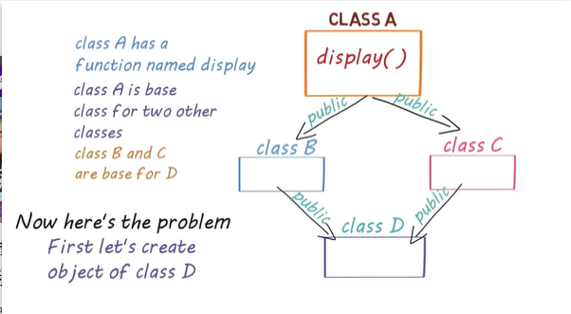


Virtual Base class
The compiler is confused because there are two paths to call the display() function. How to rectify this problem?

Slide 28
Virtual Base class
In order to remove this confusion, we use virtual while inheriting.
Example:
class B: virtual public A
class C: virtual public A
By adding the keyword virtual, the compiler will decide the path automatically.

Slide 29
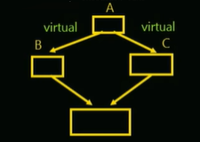
Example of Virtual Base class
class A
{
public:
void showMsg()
{
cout<<"Welcome to class A ";
}
};
class B:public A
{
};
class C:public A
{
};
class D:public B,C
{
};
int main()
{
D obj1;
obj1.showMsg();
return 0;
}

Slide 30
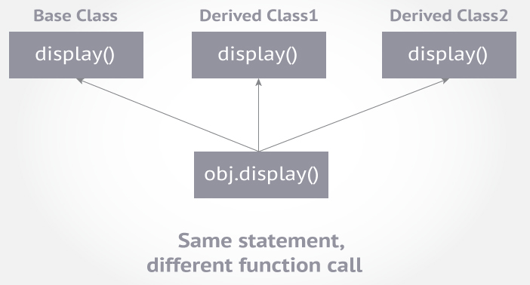
Virtual Member Function
Virtual means existing in appearance but not in reality.
A virtual function is a member function in base class that you expect to redefine in derived classes.

Slide 31
Why Are Virtual Functions Needed?
When virtual functions are used, a program that appears to be calling a function of one class may in reality be calling a function of a different class.
Suppose you have a base class “Shape” and derived classes as “Triangle”, “Ball”, “Square”, and so on…
You override the “draw()” function in each class and want to call them using the same function call.
One approach is to hold the pointers of all different objects and call them using a loop.
  shape* ptrarr[100]; // array of 100 pointers to shapes
  If we insert pointers to all the shapes into this array:
    for(int j=0; j<N; j++)
    ptrarr[j]->draw();

Slide 32
Cont…
This is an amazing capability: Completely different functions are executed by the same function call.
If the pointer in ptrarr points to a ball, the function that draws a ball is called; if it points to a triangle, the triangle-drawing function is called.
This is called polymorphism, which means “different forms” or we can call it “One Interface, Different Implementations”.
The functions have the same appearance, the draw() expression, but different actual functions are called, depending on the contents of ptrarr[j].

Slide 33
Cont…
For the polymorphic approach to work, several conditions must be met.
All the different classes of shapes, such as balls and triangles, must be descended from a single base class.
The draw() function must be declared to be virtual in the base class.

Slide 34
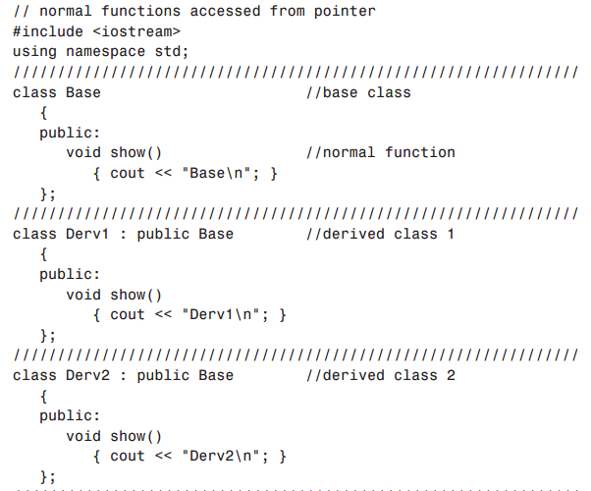
Normal Member Function Accessed with Pointers
What happens when virtual function is not used:

Slide 35
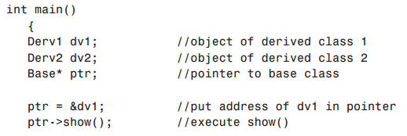
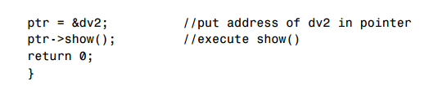
Cont…
Which of the show() function is called here?
  Base
  Base

Slide 36
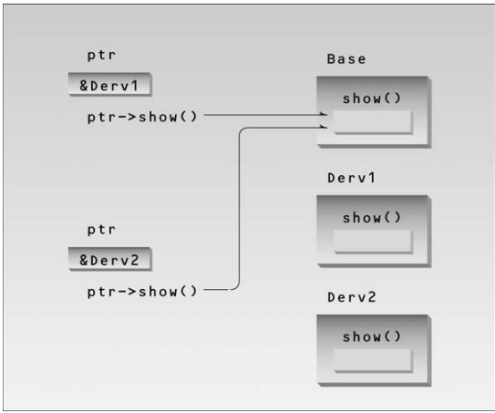
Cont…

Slide 37
Cont…
As you can see, the function in the base class is always executed.
The compiler ignores the contents of the pointer ptr and chooses the member function that matches the type of the pointer.
Sometimes this is what we want, but it doesn’t achieve the objective to implement Polymorphism.

Slide 38
Virtual Member Function Accessed with Pointers
Repeat the last program given on slides 34-35, with the following modification in the Base class:
  public:
  virtual void show() //virtual function
  {
  cout << “Base\n”;
  }
You should get the following output:
  Derv1
  Derv2

Slide 39
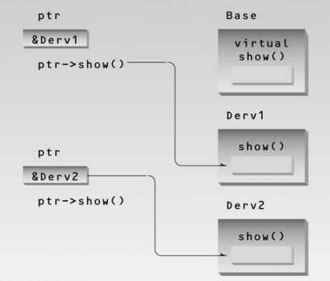
Cont…

Slide 40
Rules for Virtual Functions
They must be declared in public section of class.
Virtual functions cannot be static and also cannot be a friend function of another class.
Virtual functions should be accessed using pointer or reference of base class type to achieve run time polymorphism.
The prototype of virtual functions should be same in base as well as derived class.
They are always defined in base class and overridden in derived class. It is not mandatory for derived class to override (or re-define the virtual function), in that case base class version of function is used.

Slide 41
Pure Virtual function
A pure virtual function is a virtual function in C++ for which we need not to write any function definition and only we have to declare it. It is declared by assigning 0 in the declaration.
Example: virtual void show() =0; //no definition
It has no definition. This is also called as do nothing function.
You cannot define this function, but you must have that function in all derived classes.

Slide 42
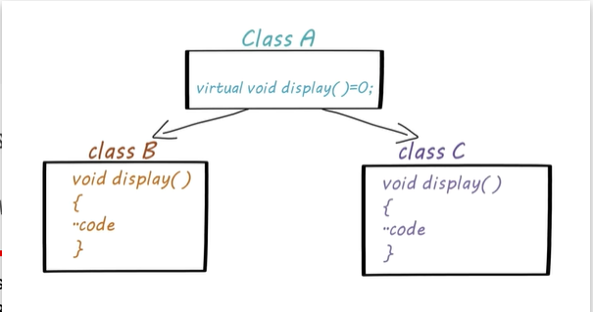
Pure Virtual Function

Slide 43
Example of Pure Virtual Function
#include<iostream>
using namespace std;
class Base
{
public:
virtual void showMsg()=0; //Pure Virtual Function
};
class Derived1:public Base
{
public:
void showMsg()
{
cout<<"Class Derived 1\n";
}
};

Slide 44
Continue…
class Derived2:public Base
{
public:
void showMsg()
{
cout<<"Class Derived 2\n";
}
};
int main()
{
Derived1 d1;
Derived2 d2;
Base* ptr;
ptr=&d1;
ptr->showMsg();
ptr=&d2;
ptr->showMsg();
return 0;
}

Slide 45
Abstract Class
An abstract class is a class in C++ which have at least one pure virtual function.
We can’t create objects of abstract class.
Then what is use of the abstract class? It is used as a base class for other derived class. All the common code (like common function) in derived classes is written in abstract class.

Slide 46
Example of Abstract Class
#include<iostream>
using namespace std;
class School
{
public:
virtual void getName()=0; // // No Definition
};
class Teacher:public School
{
public:
void getName() //Definition of the getName() function
{
cout<<"Teacher name ";
}
};

Slide 47
Continue…
class Student:public School
{
public:
void getName() //Definition of the getName() function
{
cout<<"\nStudent name ";
}
};
int main()
{
Teacher t;
Student s;
School* sPtr1=&t;
School* sPtr2=&s;
School* sPtr[2]={sPtr1,sPtr2};
for(int i=0;i<2;i++)
sPtr[i]->getName();
return 0;
}

Slide 48
Polymorphism
Polymorphism is the ability for objects of different classes related by inheritance to respond differently to the same member function call.

Slide 49
Types of Polymorphism
Compile time polymorphism/Static Binding/ Early Binding
  Achieved by “function overloading” or “operator overloading”
  When there are multiple functions with same name but different parameters then these functions are said to be overloaded.
Run-time polymorphism/Dynamic Binding/Late Binding/ Lazy Binding
  Achieved by “function overriding”
  When a derived class has a definition for one of the member functions of the base class. That base function is said to be overridden.
  Virtual functions are mainly used to achieve run-time polymorphism.

Slide 50
Function Overloading
Two or more functions with the same name appear
multiple times in the same class with different number of parameters or different order of parameters or different types of parameters.
#include <iostream>
using namespace std;
class Add {
public:
void sum(int a, int b) {
cout << a + b;
}
void sum(int a, int b, int c){
cout << a + b + c;
}
};
int main()
{
Add a;
a.sum(1,2);
cout << “\n”;
a.sum(1,2,3);
return 0;
}

Slide 51
Function Overriding
Base class and derived class have functions with the same name and same parameters
#include <iostream>
using namespace std;
class Parent {
public:
void show() {
cout << “Class Parent\n”;
}
};
class Child : public Parent {
public:
void show() {
cout << “Class Child\n”;
}
};
int main()
{
Parent p;
Child c;
p.show();
c.show();
return 0;
}
Output:
Class Parent Class Child

Slide 52
Run Time Polymorphism
Run Time Polymorphism is implemented via virtual functions.
Virtual functions have to be accessed using pointer or reference of base class to achieve run-time polymorphism.
When a request is made through a base-class pointer (or reference) to use a virtual function, C++ chooses the correct overridden function in the appropriate derived class associated with the object.

Slide 53
Run Time Polymorphism (Continued)
Derived classes Rectangle and Triangle inherit virtual function area() from base class Polygon.
Polymorphism allows C++ to decide which function area() out of the two in the derived classes to call just by letting the pointer or reference of the base class assigned to the address of the appropriate derived class.
Polygon (base class)
virtual function area()
derived from
derived from
Rectangle (derived class)
function area()
Triangle (derived class)
function area()

Slide 54
Non-polymorphic function call
If a non-virtual member function in the base class is called through a base class pointer to the derived class object, the base class version is used.
If the member function is called through a derived class pointer, the derived class version is used.
These are non-polymorphic function calls.

Slide 55
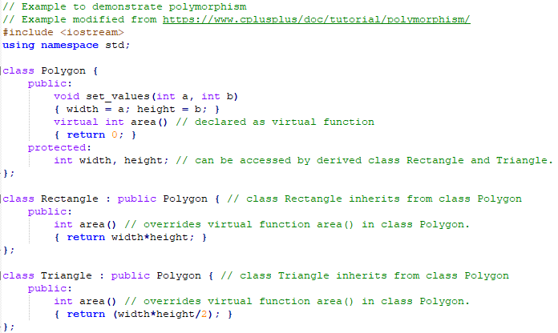
Example of polymorphism
Note the virtual function area() in the base class Polygon. It will be overridden
by derived class Rectangle and Triangle function area() with polymorphic function call.

Slide 56
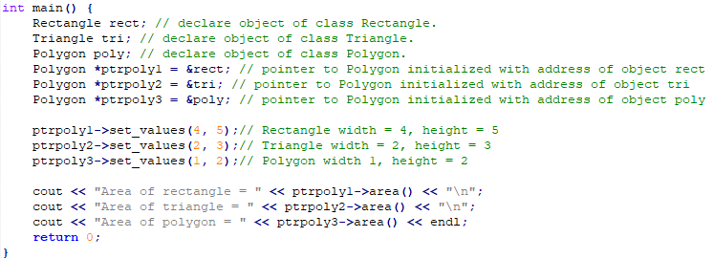
Example of polymorphism (Continued)
This section of the code is continuation from previous slide.
Polymorphism only happens when pointer of the base class pointing
to an object of the derived class attempts to access virtual function
in the base class. During run-time, the appropriate overriding function
of the derived class will be chosen. This is demonstrated in base
class pointers ptrpoly1 and ptrpoly2 in example code above.

Slide 57
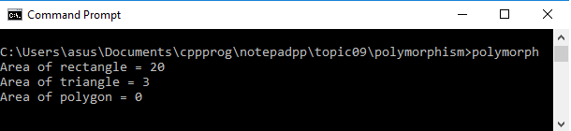
Example of polymorphism (Continued)
Output of the polymorphism example program.

Slide 58
Multiple Inheritance
So far we have discussed single inheritance.
Single inheritance is a class which is derived from exactly one base class.
If a class is derived from more than one base class, this is called multiple inheritance.
Base Class
Base Class 1
Base Class 2
derived from
derived from
derived from
Derived Class
Derived Class
Single Inheritance
Multiple Inheritance

Slide 59
Multiple Inheritance (Continued)
Multiple inheritance means that a derived class inherits the members of several base classes.

Slide 60
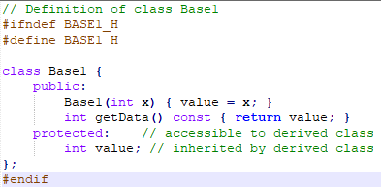
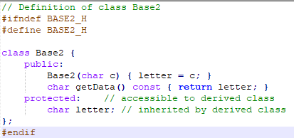
Example of Multiple Inheritance
Class declaration of
base class Base1
in “base1.h”
Class declaration of
base class Base2
in “base2.h”

Slide 61
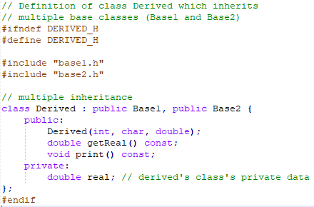
Example of Multiple Inheritance (Continued)
Class declaration of derived class Derived inherits from Base1 and Base2.

Slide 62
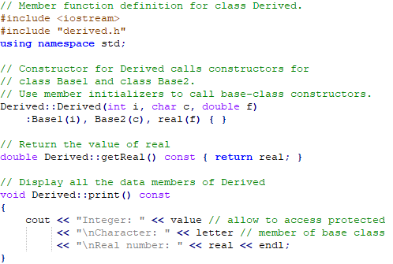
Example of Multiple Inheritance (Continued)
Member function definition of class Derived.:

Slide 63
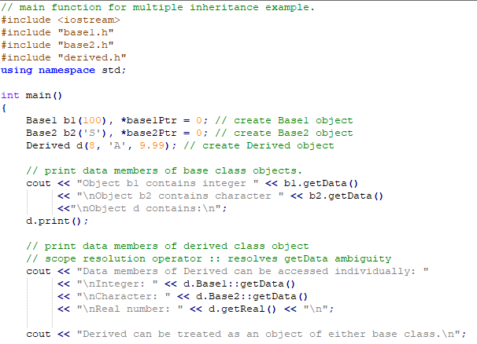
Example of Multiple Inheritance (Continued)
main function
that utilizes
the class
Base1,
class Base2,
and class
Derived.
Continue
next slide.

Slide 64
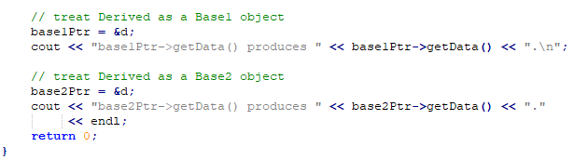
Example of Multiple Inheritance (Continued)
main function continues from previous slide.

Slide 65
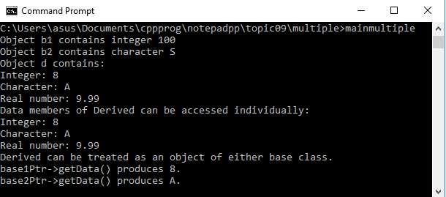
Example of Multiple Inheritance (Continued)
Output of the multiple inheritance example program.

Slide 66
References
Problem Solving with C++ (10th Edition), Walter Savitch, Addison Wesley, 2018
https://www.programiz.com/cpp-programming/inheritance
Turbo C programming for the PC, Robert Lafore
Dr.Kamran’s notes
https://www.youtube.com/c/Codearchery

